Slide 1

ORAL COMMUNICATION

Slide 2
Advantages of Speaking
Takes less time.
Needs no composing.
Gives us an opportunity to be part of human community.
Provides opportunity for feedback.
Gets the support of non-verbal communication.

Slide 3
Disadvantages of Speaking
Occurs spontaneously.
Oral communication is personal. It becomes a victim of your personality.
Cultural barriers can pose problems.
No opportunity to revise our words.
Can’t cross out what’s said and start over again.

Slide 4
Barriers to Oral Communication
Semantic Barriers
Organizational Barriers
Personal Barriers
Cross Culture Barriers
Physical Barriers
Psychological Barriers

Slide 5
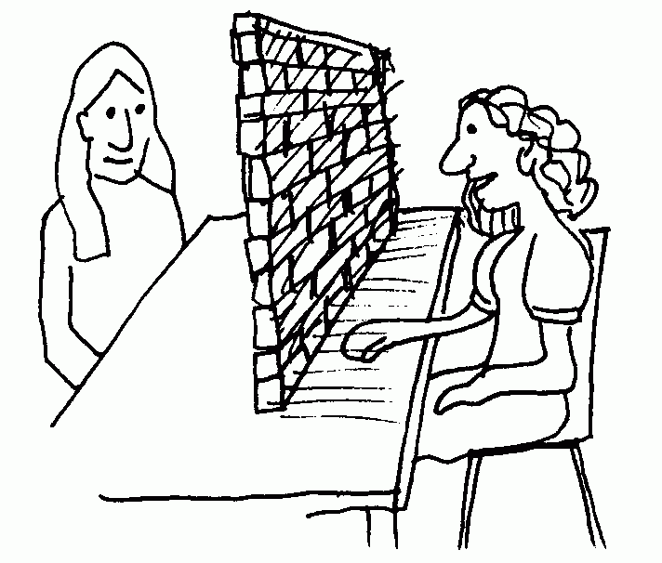
Semantic Barriers
Deals with the meaning of words and sentences.
Meaning of words are filtered through one’s frame of reference or the total knowledge of his or her beliefs, knowledge, education, culture and experience.
Wrong words, faulty translations, different interpretations etc.

Slide 6

Socio-Psychological Barriers
People have personal feelings, desires, fear, and hope, likes and dislikes, attitudes, views and opinions.
Some are formed by family background social environment.
Some are formed by individuals own intelligence, inherited qualities, education, and personal experience.
These two factors influence the way we respond to a message.

Slide 7
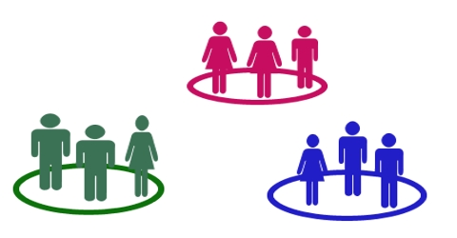
Organizational Barrier
The factors related to organization structure, authority relationships, rules and regulations may, sometimes, act as barriers to effective communication.
TYPES
• Organizational policy
• Rules and regulations
• Status
• Organizational facilities

Slide 8

Personal Barriers
The personal factors of both sender and receiver may exert influence on effective communication.
TYPES
• Fear of challenge to authority
• Lack of confidence of superior on his subordinates
• Unwillingness to communicate
• Lack of proper incentives

Slide 9

Cross-Cultural Barriers
TYPES
• Behavior
• Language

Slide 10
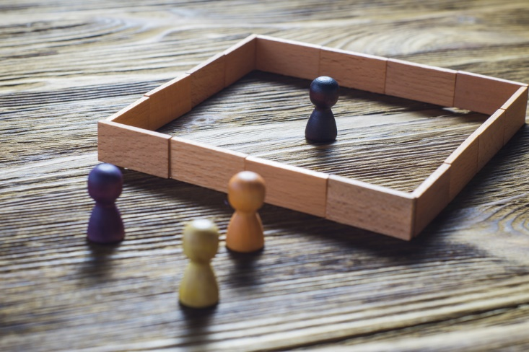
Physical Barriers
TYPES
• Environment
• Noise
• Distance
• Ignorance of Medium

Slide 11
Some other barriers may be:
Inappropriate choice of words
Lack of courtesy and consideration
Poor presentation and layout
When non-verbal communication doesn’t support the words
Lack of confidence
Inappropriate timing

Slide 12

How can you overcome these barriers?

Slide 13
Ways to over barriers
Clarify the ideas before communication.
Communicate according to the needs of receiver
Be aware of languages, tone and content of message
Ensure proper feedback
Avoid using vague, ambiguous, or confusing words, terms, jargon, and phrases, idiomatic expressions, or slangs.
Avoid using difficult words, complex sentences, unnecessary information. Use short, simple sentences.

Slide 14
More ways…
Check meanings. When communicating across cultures, never assume that the other person has understood.
Think in terms of your receiver.
Keep your message simple to promote effective communication.
Use simple, clear, accurate, correct and familiar language.
Use verbal and non-verbal messages appropriately.
Use your receiver's language.

Slide 15
Assignment: Work in groups of 4/5 members each.
ASSIGNMENT 1:
Select a famous speaker. Critically analyze his/her oral communication skills. Write an essay of 250 words on your analysis.
Submission date: Feb 23, 2021.

